Slide 1

AI-Driven Equity Research Copilot for LCP
Using GenAI agents and live market data to streamline equity research reports
By Teddy Tenetcha

Slide 2
Department Needs (Equity Research – LCP)
Produce in-depth, data-backed stock reports for portfolio managers and clients.
Cope with heavy time pressure, especially around earnings and rating changes.
Manually pull and reconcile information from multiple sources
(market data, filings, news, analyst commentary).
Maintain a consistent report structure and quality across different tickers and analysts.
Free up analyst time for higher-value work: idea generation, client conversations, and deep dives.

Slide 3
Application Vision
Create an AI-driven Equity Research Copilot that turns a ticker + focus area
(e.g., “AI & data center”) into a draft, sell-side style equity research report in minutes.
Use GenAI agents + live market data (yfinance) to auto-generate thesis, catalysts,
financial snapshot, valuation discussion, and key risks.
Keep the human analyst in control: the system drafts; the analyst reviews, edits, and signs off.

Slide 4
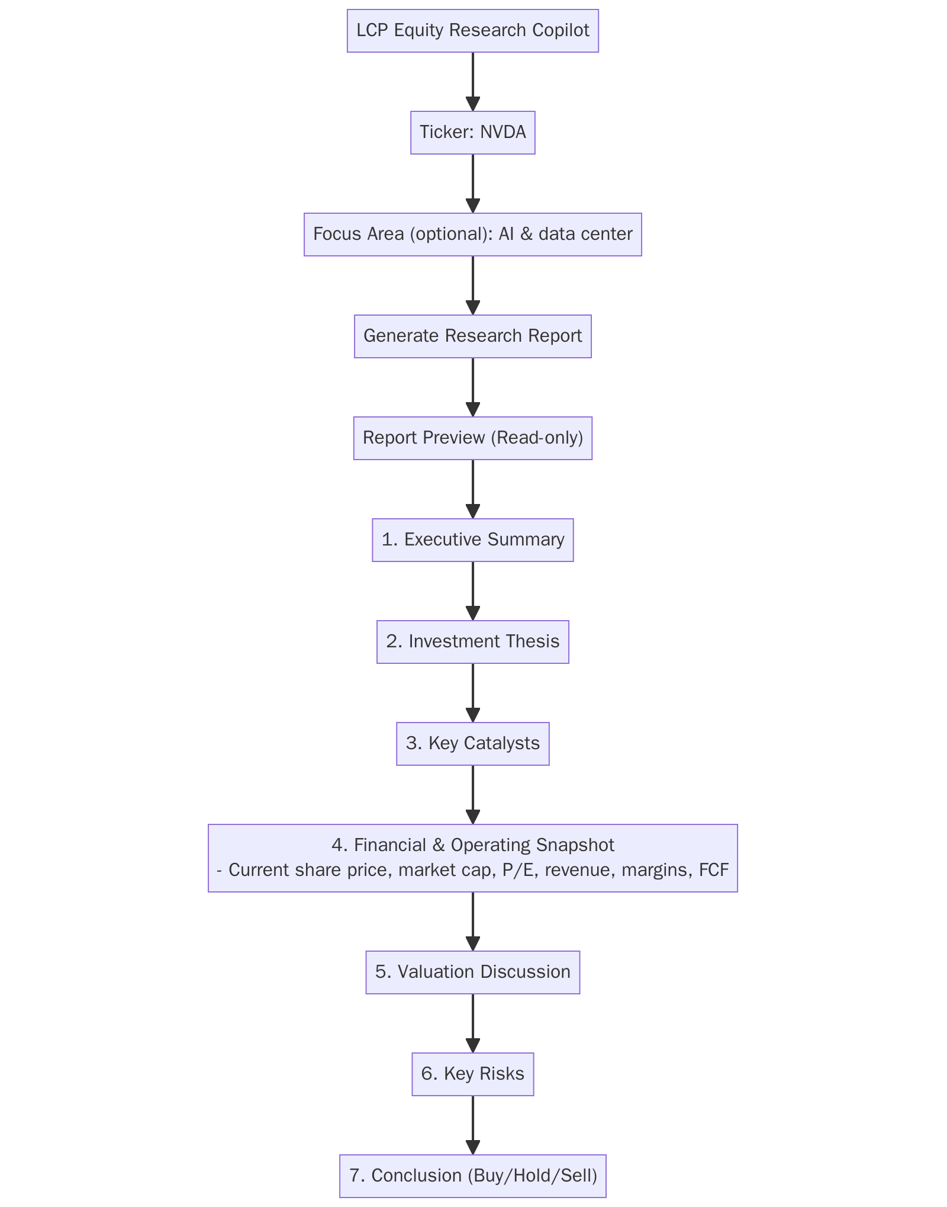
How the Equity Research Copilot Works (User Journey)
The analyst opens the LCP Equity Research Copilot.
Enters a ticker (e.g., NVDA) and an optional focus area
Examples: “AI & data center”, “gaming”, “energy exposure”.
Clicks “Generate Research Report”.
The system automatically drafts a structured equity research report with:
  Executive Summary
  Investment Thesis
  Key Catalysts
  Financial & Operating Snapshot (with live metrics)
  Valuation Discussion
  Key Risks
  Conclusion (Buy / Hold / Sell – no price target)
The analyst then reviews, edits, and approves the report before sharing it.

Slide 5
What Happens Behind the Scenes
1. Information Gathering
DataAgent: pulls company and industry data.
FinancialDataAgent: fetches live market and financial data (price, market cap,
MarketTrendsAgent: summarizes analyst-commentary and sector trends relevant to the ticker and focus area.
2. Analysis & Valuation
AnalystAgent: behaves like a junior analyst – combines the context, numbers, and trends into an integrated view
ValuationAgent: interprets valuation using the metrics (multiples, growth, profitability) and the focus area.
3. Risk & Communication
RiskReviewerAgent: does a second pass to highlight regulatory, competitive, and macro risks.
WriterAgent: turns all of this into a sell-side style report with our standard structure.
ReflectionAgent: lightly edits for clarity, consistency, and professional tone.

Slide 6
Core Functionality & Impact
Data-backed first drafts:
Uses live market data (price, market cap, revenue, margins, FCF, 52-week range).
Ensures the Financial & Operating Snapshot and valuation sections are grounded in numbers.
Personalized analysis:
Optional focus area steers the narrative (e.g., AI & data center vs gaming vs energy).
MarketTrendsAgent highlights trends and commentary most relevant to that theme.
Speed & consistency:
Draft report generated in minutes instead of hours.
Common structure across names: thesis, catalysts, snapshot, valuation, risks.
Human-in-the-loop by design:
Output is a draft, not an automated rating.
Analysts remain responsible for final judgment and compliance.

Slide 7
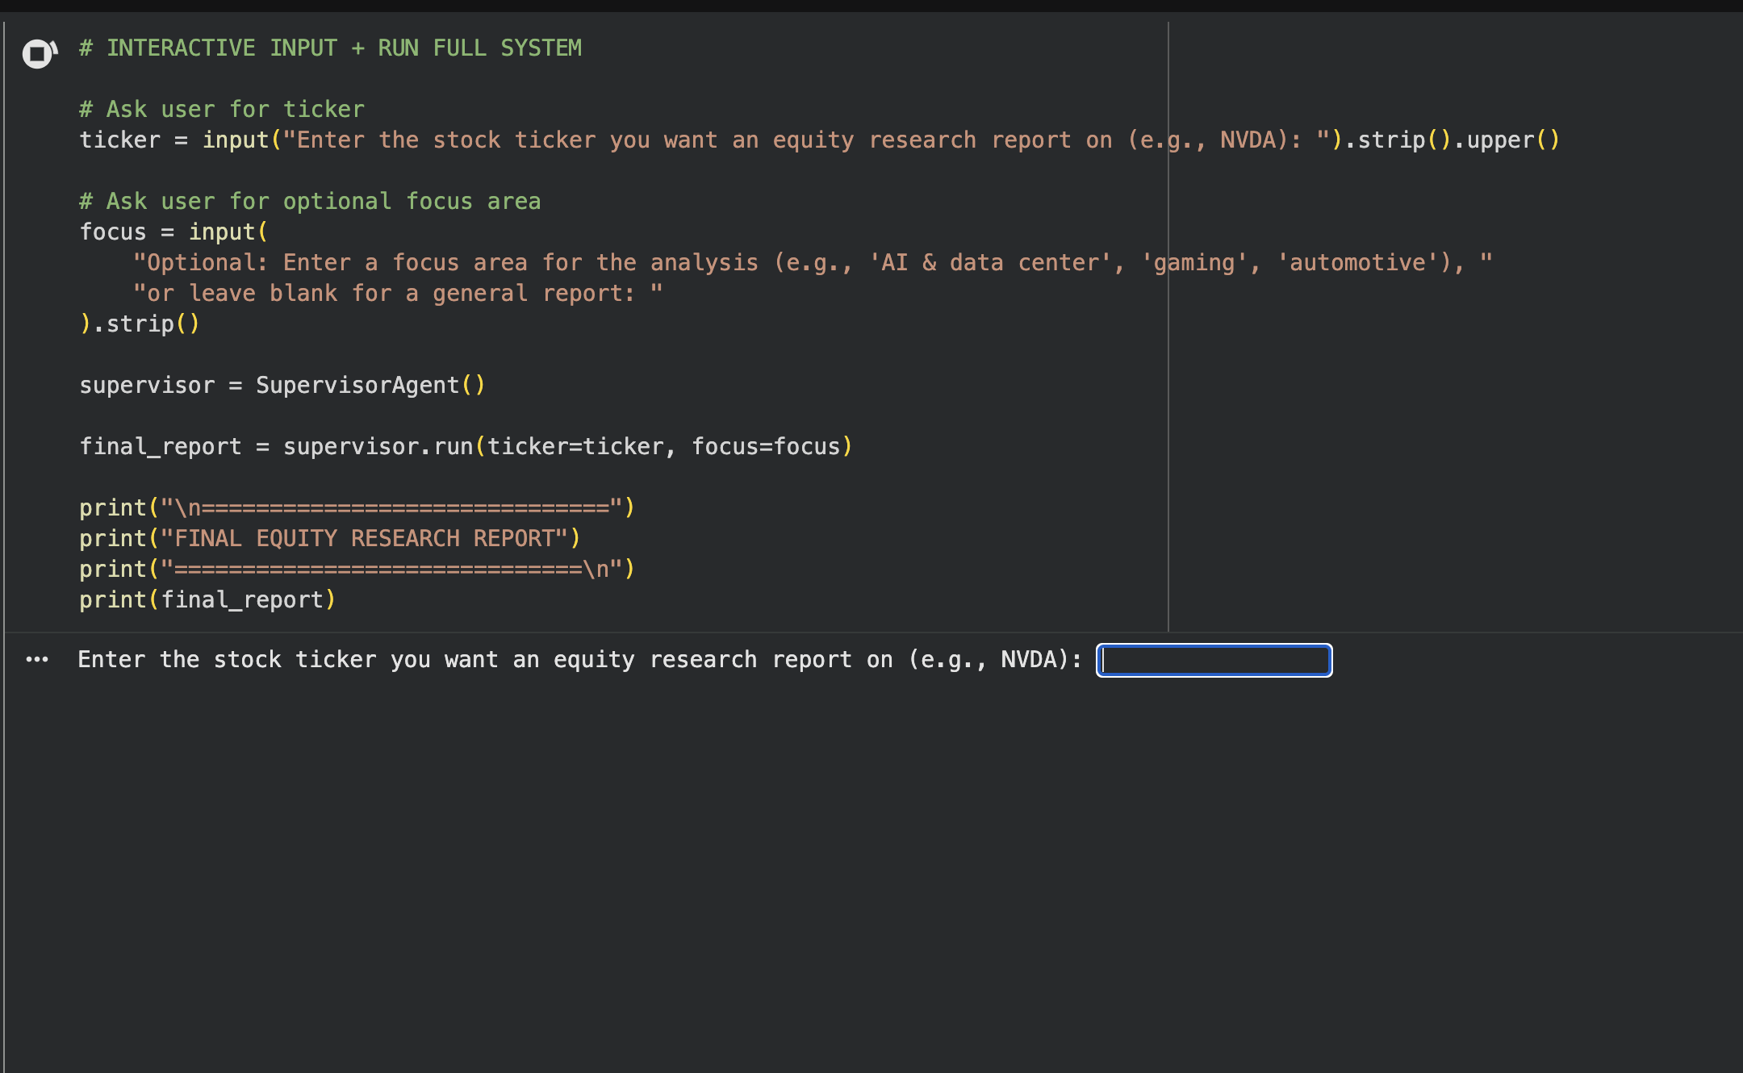
Prototype Demonstration
Current prototype is implemented in Google Colab, but mimics a simple internal tool UI.
The analyst only interacts with one cell:
Enters a stock ticker (e.g., NVDA).
Optionally enters a focus area (e.g., “AI & data center”, “gaming”, “Energy”).
On Run, this single cell calls:
supervisor = SupervisorAgent() final_report = supervisor.run(ticker=ticker, focus=focus)
Behind this simple interface, the entire multi-agent pipeline executes:
Data collection → financial metrics → market trends → analysis → valuation → risks → report writing.
Goal: keep the user experience simple and familiar for equity analysts while hiding GenAI complexity under the hood.

Slide 8
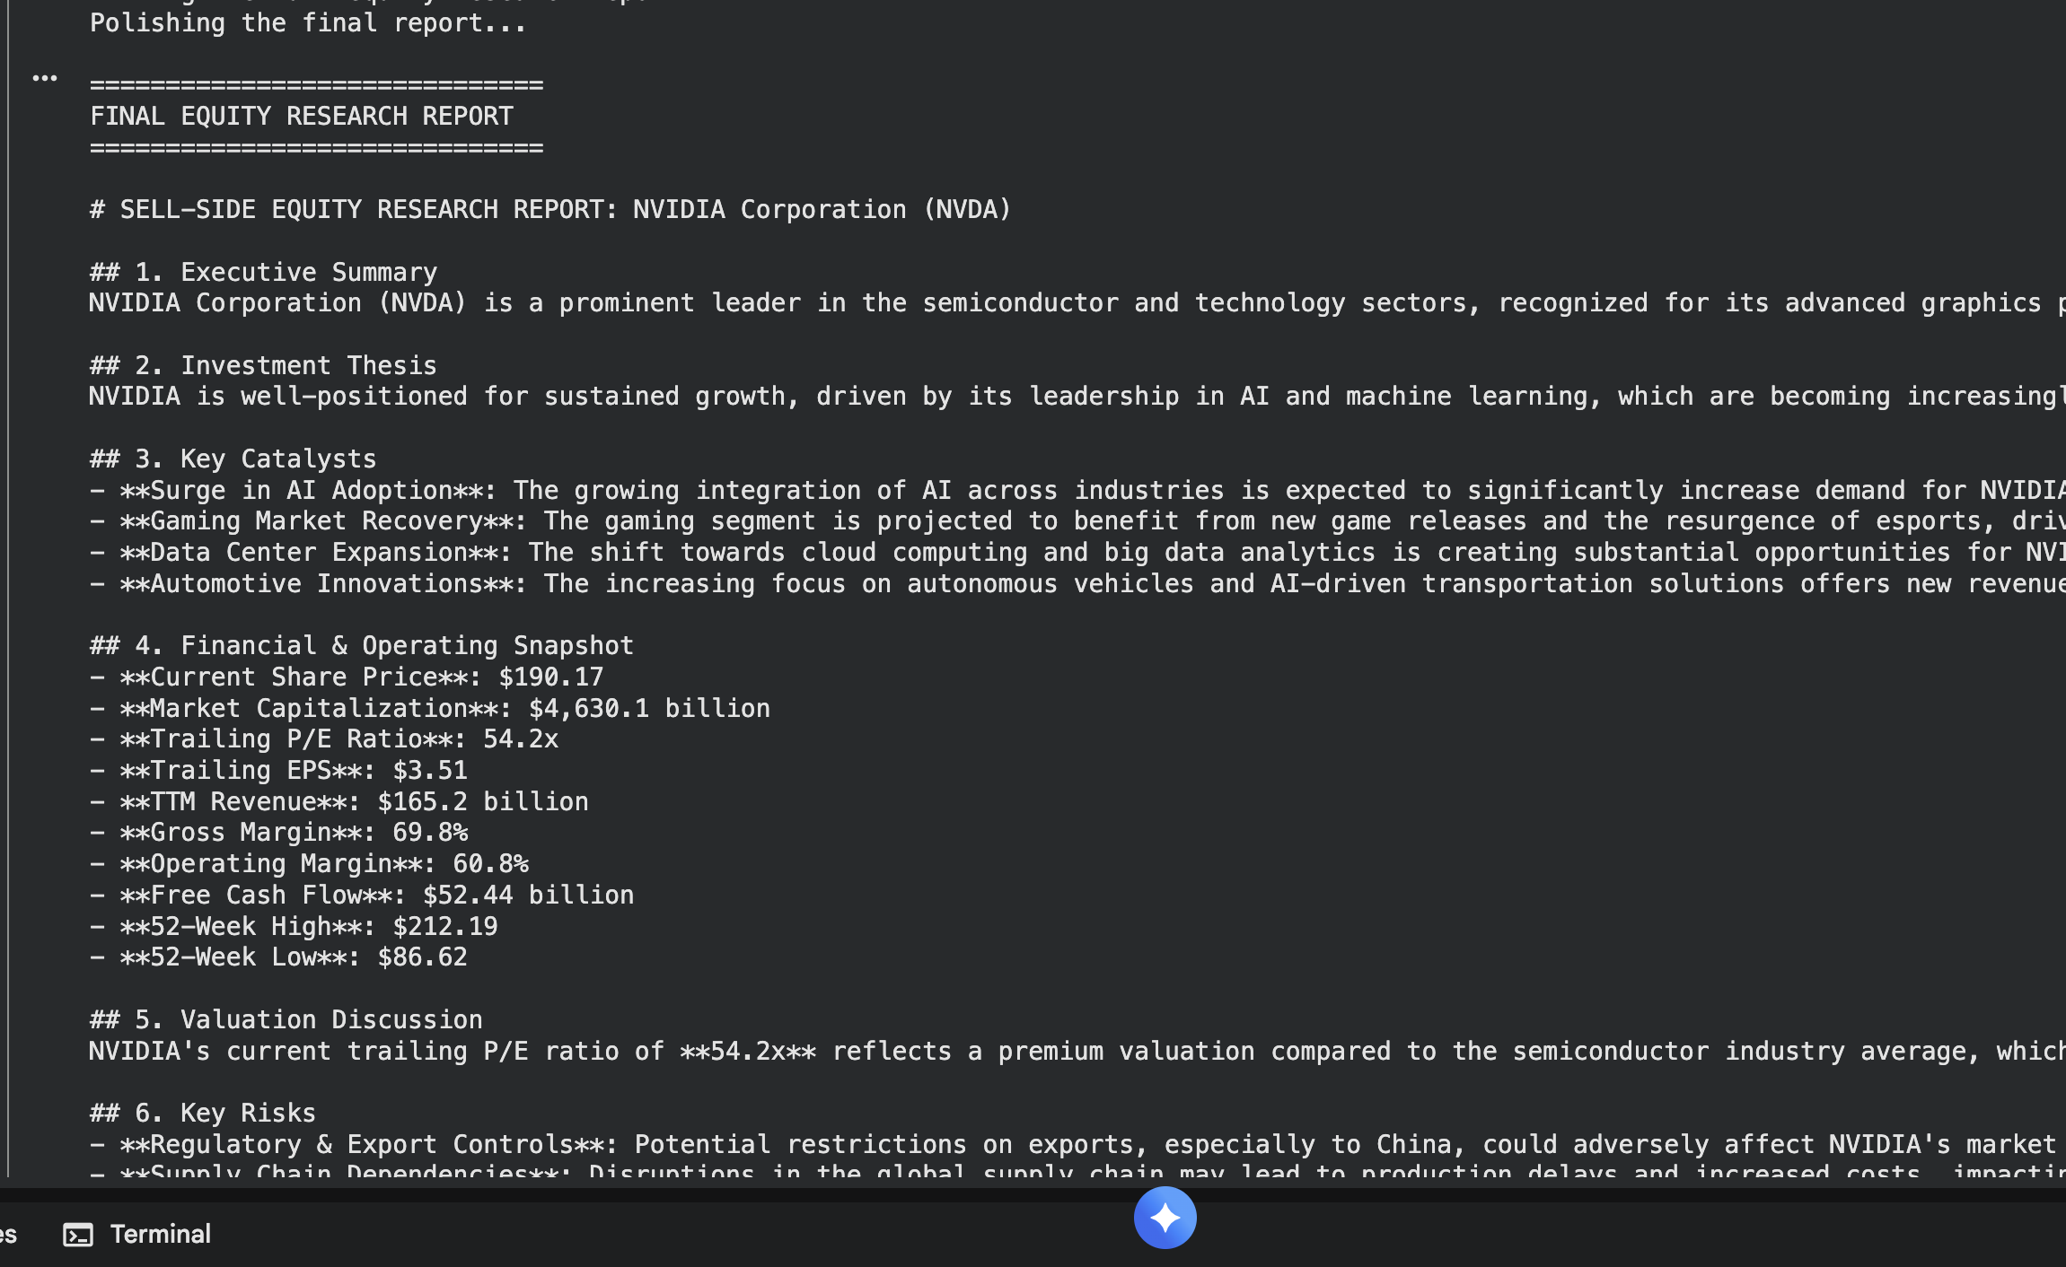
Prototype Output: NVDA Equity Research Report
Auto-generated sell-side style report for NVIDIA (NVDA).
Standard sections: Executive Summary, Investment Thesis, etc.
Snapshot is data-backed using live metrics (price, market cap, P/E, revenue, ect).
Analysts can review and edit this draft just like a junior analyst’s first version.

Slide 9
How the Research Copilot Improves Equity Research at LCP
Accelerates report creation
Drafts full equity research reports in minutes instead of hours, reducing repetitive writing work.
Enhances analyst productivity
Frees analysts to focus on idea generation, modeling, and client discussions rather than gathering data and writing boilerplate sections.
Scalable across coverage universe
Generates first-draft reports for any ticker, enabling faster coverage expansion without needing more headcount.

Slide 10
Implementation Challenges & Risks
1. Data Quality & Model Accuracy
GenAI may misinterpret less-followed companies or produce inaccurate qualitative descriptions.
Mitigation: Require analyst review; anchor outputs to verified financial data.
2. Analyst Adoption & Trust
Some team members may be hesitant to rely on AI-generated reports.
Mitigation: Position the tool as a first-draft assistant, not a replacement; provide training and demonstrations.
3. Integration with Existing Research Workflows
Connecting the tool to internal databases, modeling tools, or compliance processes may be complex.
Mitigation: Launch as a standalone prototype first; integrate gradually based on user feedback.

Slide 11

Thank you

